Slide 1

Writing better APIs with MicroProfile GraphQL
Phillip Krüger
July 2019

Slide 2
The Story
How did I get here
Testing the waters
Playing around
Specification

Slide 3
1.
Painting a picture
Giving you some context

Slide 4
BIG COMPANY

Slide 6


Slide 7



Slide 8


Legacy
FTP
AS400
SOAP
REST
RMI
Java
It’s awesome ! Going to solve ALL our problems.

Slide 10
Ladies and gentlemen: the story you are about to hear is true. Only the names have been changed to protect the innocent..

Slide 11
@GET
@Path("/{userId}")
public Profile getProfile(@PathParam("userId") int userId){
// Here find all data and return profile
}
Person
Profile
id: Long
surname: String
…..
names: String[]
Score
id: Long
person: Person
scores: List<Scores>
id: Long
type: ScoreType
value: ScoreValue

Slide 12
{
"id": 0,
"person": {
"addresses": [
{
"code": "86055-2543",
"lines": [
"20952 Warren Village",
"North Rodrick",
"New York",
"Croatia"
]
},
{
"code": "62300",
"lines": [
"49273 Ernser Wells",
"Kuhlmanfort",
"Georgia",
"Djibouti"
]
}
],
"biography": "Deleniti a ut unde perspiciatis qui est tempora. Velit asperiores et. Ex numquam quos reiciendis placeat vitae sint repudiandae.
Ratione molestiae delectus natus consequatur. Est a molestias nostrum rerum et odio blanditiis. Veritatis ducimus et consequatur modi.
Necessitatibus aut rerum. Distinctio debitis quidem eum beatae officiis.",
"birthDate": "27/10/1999",
"coverphotos": [
"http://lorempixel.com/g/1600/1200/business/"
],
"creditCards": [
{
"expiry": "2011-10-12",
"number": "1234-2121-1221-1211",
"type": "mastercard"
}
],
"emailAddresses": [
"missy.fritsch@gmail.com",
"chadwick.keebler@yahoo.com"
],
"favColor": "ivory",
"gender": "Female",
"id": 1,
"idNumber": "802-18-8226",
"imClients": [
{
"identifier": "Slack",
"im": "cole.waelchi"
},
{
"identifier": "ICQ",
"im": "barry.bergnaum"
}
],
"interests": [
"Overwatch",
"vinyl"
],
"joinDate": "24/09/2017",
"locale": "en-ZA",
"maritalStatus": "Divorced",
"names": [
"Alexandra",
"Leonia"
],
"nicknames": [
"Annie Moore"
],
"occupation": "Producer",
"organization": "Jerde-Kertzmann",
"phoneNumbers": [
{
"number": "158-692-8487",
"type": "Cell"
},
{
"number": "307.717.3673 x798",
"type": "Home"
},
{
"number": "1-833-310-6728",
"type": "Work"
}
],
"profilePictures": [
"https://s3.amazonaws.com/uifaces/faces/twitter/enda/128.jpg"
],
"relations": [
{
"personURI": "/rest/person/708",
"relationType": "Spouse"
}
],
"skills": [
"Networking skills",
"Fast learner"
],
"socialMedias": [
{
"name": "@florentino.bahringer",
"username": "Twitter"
},
{
"name": "ryan.christiansen",
"username": "Facebook"
}
],
"surname": "Gleichner",
"taglines": [
"The dark side clouds everything. Impossible to see the future is.",
"Chuck Norris burst the dot com bubble."
],
"title": "Miss",
"userAgent": "Opera/9.80 (X11; Linux i686; Ubuntu/14.10) Presto/2.12.388 Version/12.16",
"username": "nolan.roberts",
"websites": [
"http://www.burt-zieme.io",
"http://www.artie-windler.co"
]
},
"scores": [
{
"name": "Driving",
"value": 8
},
{
"name": "Fitness",
"value": 8
},
{
"name": "Activity",
"value": 77
},
{
"name": "Financial",
"value": 15
}
]
}

Slide 13
?

Slide 14
{
"id": "062-42-0952",
"person": "/rest/person/1",
"scores": "/rest/score/062-42-0952"
}
HATEOAS
It’s awesome ! Going to solve ALL our problems.

Slide 15
{
"id": 0,
"person": {
"addresses": [
{
"code": "86055-2543",
"lines": [
"20952 Warren Village",
"North Rodrick",
"New York",
"Croatia"
]
},
{
"code": "62300",
"lines": [
"49273 Ernser Wells",
"Kuhlmanfort",
"Georgia",
"Djibouti"
]
}
],
"biography": "Deleniti a ut unde perspiciatis qui est tempora. Velit asperiores et. Ex numquam quos reiciendis placeat vitae sint repudiandae.
Ratione molestiae delectus natus consequatur. Est a molestias nostrum rerum et odio blanditiis. Veritatis ducimus et consequatur modi.
Necessitatibus aut rerum. Distinctio debitis quidem eum beatae officiis.",
"birthDate": "27/10/1999",
"occupation": "Producer",
"organization": "Jerde-Kertzmann",
"phoneNumbers": [
{
"number": "158-692-8487",
"type": "Cell"
},
{
"number": "307.717.3673 x798",
"type": "Home"
},
{
"number": "1-833-310-6728",
"type": "Work"
}
],
"profilePictures": [
"https://s3.amazonaws.com/uifaces/faces/twitter/enda/128.jpg"
],
"relations": [
{
"personURI": "/rest/person/708",
"relationType": "Spouse"
}
],
"skills": [
"Networking skills",
BFF

Slide 16
@GET
@Path("/{userId}")
public Profile getProfile(@PathParam("userId") int userId){
// Here find all data and return profile
}
@GET
@Path("/lite/{userId}")
public ProfileLite getLiteProfile(@PathParam("userId") int userId){
// Here find some data and return profile
}

Slide 17
?

Slide 18
@GET
@Path("/{userId}")
public Profile getProfile(@PathParam("userId") int userId){
// Here find all data and return profile
}
@GET
@Path("/lite/{userId}")
public ProfileLite getLiteProfile(@PathParam("userId") int userId){
// Here find some data and return profile
}
@GET
@Path("/lite/status/{userId}")
public ProfileLiteWithStatus getLiteProfileWithStatus(@PathParam("userId") int userId){
// Here find some data (and the status) and return profile
}

Slide 19
@GET
@Path("/{userId}")
public Profile getProfile(@PathParam("userId") int userId){
// Here find all data and return profile
}
@GET
@Path("/{userId}")
public Profile getProfile(@PathParam("userId") int userId,
@QueryParam("include") String[] include,
@QueryParam("exclude") String[] exclude){
// Here find all data and return profile
}
@GET
@Path("/lite/{userId}")
public ProfileLite getLiteProfile(@PathParam("userId") int userId){
// Here find some data and return profile
}

Slide 20
Over-fetching is fetching too much data, aka there is data in the response you don't use.
Under-fetching is not having enough data with a call to an endpoint, leading you to call a second endpoint.

Slide 21
?
?
?
?
?

Slide 22
2.
Drawing board
Back to the
Surely someone else have these issues ?

Slide 23

Options
HATEOAS
BFF
Queryable REST

Slide 24

GraphQL
It’s awesome ! Going to solve ALL our problems.

Slide 25

History
Developed and open sourced by Facebook
Specification http://facebook.github.io/graphql
Alternative to REST
Declarative data fetching
Increased mobile usage
Variety of different frontend frameworks
Rapid feature development
Since 2012. Publically 2015

Slide 26
Some benefits
Data Fetching
No more Over- and Under Fetching
Development Speed
Rapid Product Iterations on the Frontend
Schema
Benefits of a Schema & Type System

Slide 27
REST
GET: /rest/profile/5234
Profile
GET: /rest/person/98763
Person
https://www.howtographql.com
GET: /rest/score/A53FG5
Score

Slide 28
{
profile(personId: 1){
person{
names
surname
occupation
}
scores {
name
value
}
}
}
GraphQL
https://www.howtographql.com
{
"data": {
"profile": {
"person": {
"names": [
"Sebastian",
"Jana"
],
"surname": "Heathcote",
"occupation": "Officer"
},
"scores": [
{
"name": "Driving",
"value": 78
}
]
}
}
}
Profile
POST: /graphql

Slide 29
GraphQL
{
profile(personId: 1) {
person{
title
surname
}
}
}
https://www.howtographql.com
Profile
POST: /graphql
{
"data": {
"profile": {
"person": {
"title": "Mrs.",
"surname": "Heathcote"
}
}
}
}

Slide 30
GraphQL Schema
type Query {
profile(personId: Int!): Profile @_mappedOperation(operation : "__internal__")
}
type Relation @_mappedType(type : "__internal__") {
personURI: String @_mappedOperation(operation : "__internal__")
relationType: RelationType @_mappedOperation(operation : "__internal__")
}
type Score @_mappedType(type : "__internal__") {
name: ScoreType @_mappedOperation(operation : "__internal__")
value: Long @_mappedOperation(operation : "__internal__")
}
type SocialMedia @_mappedType(type : "__internal__") {
name: String @_mappedOperation(operation : "__internal__")
username: String @_mappedOperation(operation : "__internal__")
}
enum Gender {
Female
Male
}
type Person @_mappedType(type : "__internal__") {
addresses: [Address] @_mappedOperation(operation : "__internal__")
biography: String @_mappedOperation(operation : "__internal__")
birthDate: LocalDate @_mappedOperation(operation : "__internal__")
coverphotos: [URL] @_mappedOperation(operation : "__internal__")
creditCards: [CreditCard] @_mappedOperation(operation : "__internal__")
emailAddresses: [String] @_mappedOperation(operation : "__internal__")
favColor: String @_mappedOperation(operation : "__internal__")
gender: Gender @_mappedOperation(operation : "__internal__")
id: Int! @_mappedOperation(operation : "__internal__")
idNumber: String @_mappedOperation(operation : "__internal__")
imClients: [ImClient] @_mappedOperation(operation : "__internal__")
interests: [String] @_mappedOperation(operation : "__internal__")
joinDate: LocalDate @_mappedOperation(operation : "__internal__")
locale: String @_mappedOperation(operation : "__internal__")

Slide 31


GraphQL in the Java world
graphql-java
graphql-spqr
@andimarek
@kaqqao

Slide 32
Links
https://www.howtographql.com/graphql-java/0-introduction/
https://www.graphql-java.com/
https://github.com/leangen/graphql-spqr
https://www.phillip-kruger.com/post/graphql_on_wildfly_swarm
https://github.com/phillip-kruger/membership
https://jefrajames.wordpress.com/2019/03/08/graphql-with-kumuluzee/

Slide 33
3.
Community
Anyone interested to creating a specification for this ?

Slide 34

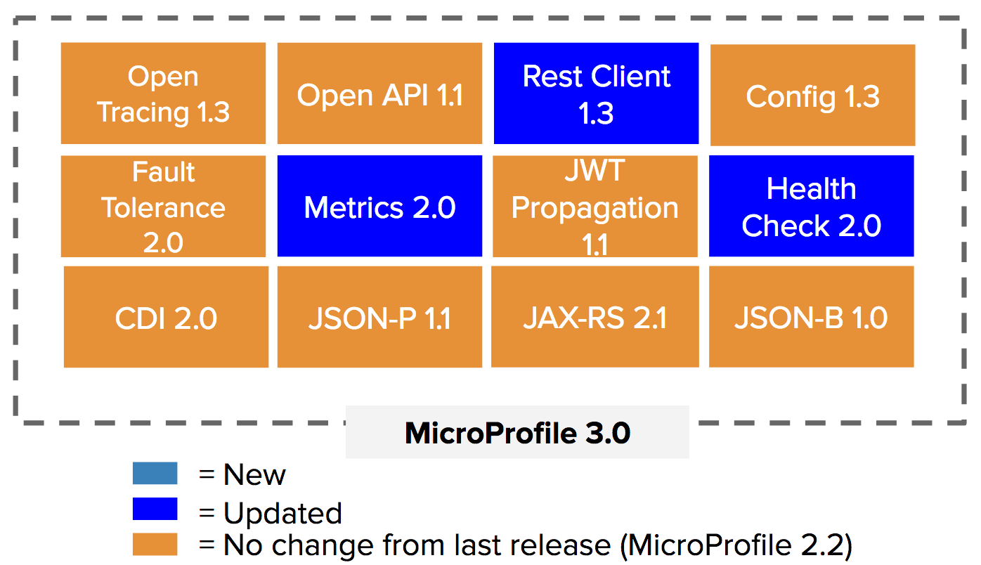

MicroProfile
Optimizing Enterprise Java for a Microservices Architecture

Slide 35
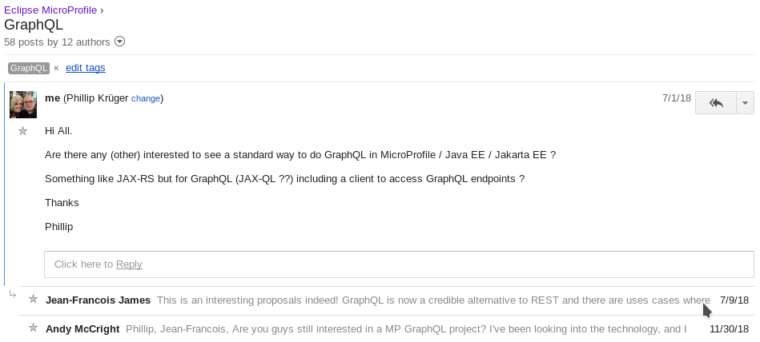
https://groups.google.com/forum/#!forum/microprofile

Slide 36
Blog Posts
Discussions
Sandbox
Proposal
POC

Slide 37





MicroProfile GraphQL workgroup

Slide 38
PROCESS
sandbox
standalone
umbrella

Slide 39
4.
Specification
GraphQL specification under MicroProfile

Slide 40



MicroProfile GraphQL 1.0
https://github.com/eclipse/microprofile-graphql
Spec
(Asciidoc)
API
(Java interfaces & Annotations)
TCK
(TestNG)
CI
(Java)

Slide 41
Person
id: Long
surname: String
…..
names: String[]
Profile
Score
id: Long
person: Person
scores: List<Scores>
id: Long
type: ScoreType
value: ScoreValue

Slide 42
@GraphQLApi
public class ProfileGraphQLApi {
@Query
public Profile profile(@Argument("personId") int personId) {
Person person = personDB.getPerson(personId);
List<Score> scores = scoreDB.getScores(person.getIdNumber());
Profile profile = new Profile();
profile.setId(person.getIdNumber());
profile.setPerson(person);
profile.setScores(scores);
return profile;
}
}

Slide 43
Demo 1
https://github.com/phillip-kruger/graphql-example

Slide 44
Person
id: Long
surname: String
…..
names: String[]
Profile
Score
id: Long
person: Person
scores: List<Scores>
id: Long
type: ScoreType
value: ScoreValue

Slide 45
@Query
public Profile profile(@Argument("personId") int personId) {
Person person = personDB.getPerson(personId);
//List<Score> scores = scoreDB.getScores(person.getIdNumber());
Profile profile = new Profile();
profile.setId(person.getIdNumber());
profile.setPerson(person);
//profile.setScores(scores);
return profile;
}
@Query
public List<Score> scores(@Source Profile profile) {
Person person = profile.getPerson();
return scoreDB.getScores(person.getIdNumber());
}

Slide 46
Demo 2
https://github.com/phillip-kruger/graphql-example

Slide 47
Person
id: Long
surname: String
…..
names: String[]
Profile
Score
id: Long
person: Person
scores: List<Scores>
id: Long
type: ScoreType
value: ScoreValue

Slide 48
@Query
public Person person(@Argument("personId") int personId){
return personDB.getPerson(personId);
}
@Query
public List<Score> scores(@Source Person person) {
return scoreDB.getScores(person.getIdNumber());
}

Slide 49
Demo 3
https://github.com/phillip-kruger/graphql-example

Slide 50
OTHER CONCEPTS
@Query many
@Query("people")
public List<Person> getPeople(){
return personDB.getPeople();
}
(Demo 4)
@Mutation (add & update)
@Mutation("updatePerson")
public Person updatePerson(
@Argument("person") Person person){
return personDB.updatePerson(person);
}
(Demo 5)
{
people {
surname
}
}
mutation CreatePerson {
person(person:{names: "Piet"}){
id
}
}

Slide 51
OTHER CONCEPTS
@Mutation (delete)
@Mutation("deletePerson")
public Person deletePerson(
@Argument("id") int id){
return personDB.deletePerson(id);
}
Fragments
{
person(personId:2){
...mobilePerson
}
}
fragment mobilePerson on Person {
title
surname
}
mutation DeletePerson {
deletePerson(id:1){
surname
}
}

Slide 52
OTHER CONCEPTS
@Query
public List<Person> personsWithSurname(@Argument("surname")
@DefaultValue("Kruger")
String surname) {
}
query GetPeopleWithSurname($surname:String = "Green"){
personsWithSurname(surname:$surname){
names
}
}

Slide 53
OTHER CONCEPTS
@InputType
@Type
@Jsonb**
@Deprecated
@Ignore

Slide 54



Implementations in Progress

Slide 55








MicroProfile Umbrella Implementations

Slide 56



THANKS!
?
Any questions?
You can find me at www.phillip-kruger.com
@phillipkruger
http://bit.ly/mp-graphql-presentation
http://bit.ly/mp-graphql-example

Slide 57
CREDITS
Special thanks to all the people who made and released these awesome resources for free:
Presentation template by SlidesCarnival
Icons by HandDrawnGoods
Code markup with SlidesCodeHighlighter

